Slide 1
REED MULLER CODES ACHIEVE CAPACITY ON ERASURE CHANNELS S.Kudekar,S.Kumar,M.Mondelli,H.D.Pfister,E.Sasoglu,R.Urbanke
E2:207:Concentration Inequalities
Course Project Report
by
Ramakrishnan
Soumya Subhra Banerjee
ECE,IISc
December 2,2017

Slide 2
Motivation
The channel capacity is the largest rate at which communication can be made with arbitrary small error.
Channel coding tells us how capacity can be achieved.
Turbo , SC-LDPC achieve capacity, but no proof is presented yet
Polar and Reed-Muller were proved to achieve Capacity...
Another* answer to the search for PROVABLY capacity achieving channel codes.
Perhaps one of the most important applications of threshold phenomenon.
Establishes that a certain class of codes achieve capacity, Which include Reed-Muller codes,Polar codes.
*That polar codes achieve capacity was proved by E.Arikan before this.
This provides an alternate method of the same proof leveraging fewer properties of polar codes

Slide 3
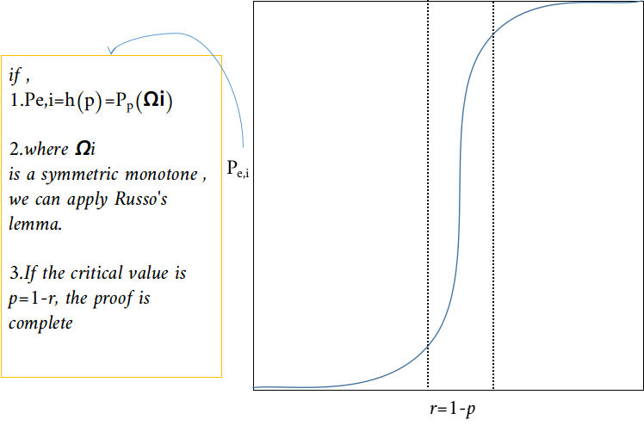
Channel Capacity from the perspective of Threshold Phenomenon...proof idea
For transmission over BEC(p), with Capacity r=1-p
For a sequence of binary linear codes with rate r to be capacity achieving, the bit error probability,must converge to 0 for any erasure rate below 1 − r.
To prove this using Threshold Phenomenon.
Bit Error Probability for a code , under MAP decoding needs to be captured by a function of erasure probability.We shall explore MAP EXIT (Extrinsic Information Transfer) functions for this.
MAP EXIT function should be expressed as measure of a monotone set
The influences of the set must be equal , in other words ,the set must be symmetric.This happens when we assume the code is 2-transitive under automorphic permutation.
Hence we will apply Russo's lemma.
The critical value will occur at p=1-r, this follows, from Area theorem
RM codes , Polar codes are 2-transitive.

Slide 4
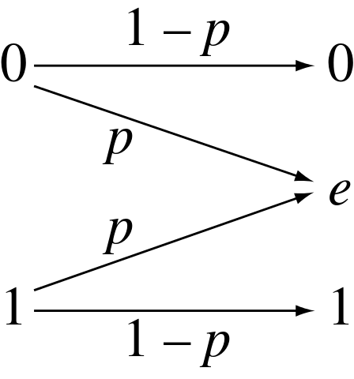


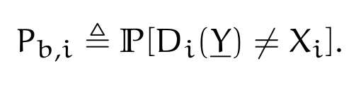
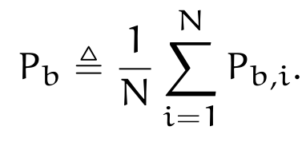



Bit Map Decoding under BEC
Decoding rule
Bit error Probability
=p
Observation 1, Bit error probability = Transinformation:
, ,if X_{i} is Ber(1/2).
Proof:
if X_{i} can be recovered from
Else ,

Slide 5

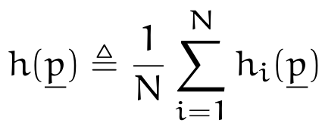

MAP EXIT functions...to capture bit error probability
Definition:
the vector EXIT function associated with bit i,
the average EXIT function,
we can choose p_{i}=p for all i.
Implication:
It is the Transinformation associated with each bit 'i',which comes from all bits of received vector except bit 'i' (hence the name EXtrinsic Information Transfer)
Observation 2,Bit error probability vs EXIT function:
By definition of conditional Entropy...
Further using Observation 1,

Slide 6
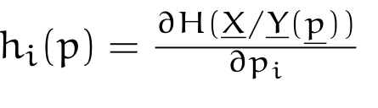
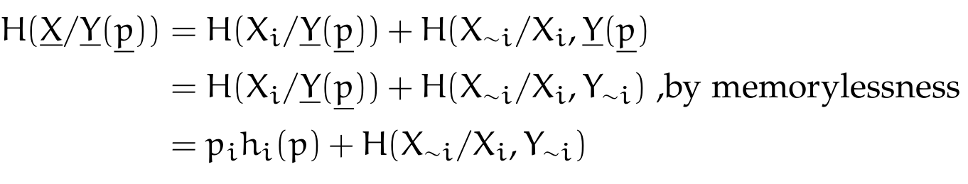
MAP EXIT function ...area theorem
Propostion 1*.
The MAP EXIT function satisfies ...
Proof:
noting that the second term is independent of pi, and differentiating gives the above result.
* Note the propositions are numbered according to original paper

Slide 7
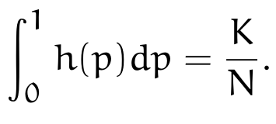

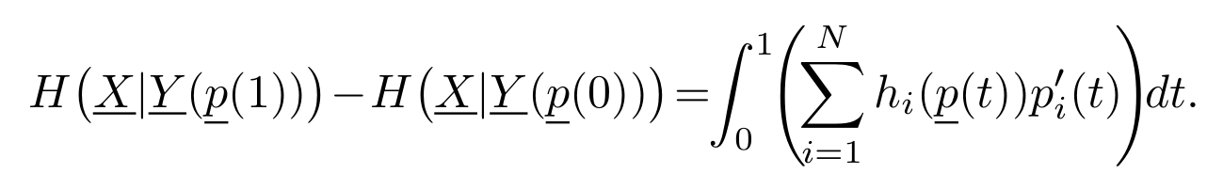


MAP EXIT function ...area theorem
Proposition 4(c), Area Theorem:
The area under average EXIT function is equal to the rate
Implication:
This theorem will govern where the threshold will lie.
Proof:
from proposition 1,
this implies, for a parameterized vector, , t Є(0,1)
consider p_{i}(t)=t
noting, , , ,,and using the definition of h(p) completes the proof.

Slide 8
MAP EXIT function ...as a measure of a set
Consider bit erasure pattern a as a indicator vector s.t. a_{i}=1_{{ Yi=e}}
A binary vector a covers another vector c if a_{i} > c_{i,} for all i.
A transmitted codeword can be recovered iff the erasure pattern does not cover any codeword.
A bit i can be recovered uniquely iff the error pattern does not cover any codeword where bit i is non-zero.
 | 1 | 2 | 3 | 4 | 5 | 6 | E does not cover
E | 1 | 0 | 0 | 1 | 0 | 0
C1 | 1 | 0 | 1 | 1 | 1 | 0 | True
C2 | 1 | 1 | 0 | 1 | 0 | 1 | True
C3 | 1 | 0 | 0 | 1 | 0 | 0 | True
C4 | 1 | 0 | 0 | 0 | 0 | 0 | X

Slide 9
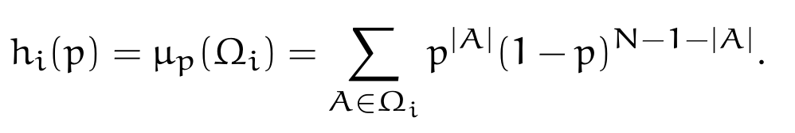
MAP EXIT function ...as a measure of a set
Indirect Recovery:Consider a code C and the indirect recovery of X_{i} from the subvector Y_{∼i} (i.e., the bit-MAP decoding of Y_{i} from Y when Y_{i} = e).
For i ∈ [N], the set of erasure patterns that prevent indirect recovery of X_{i} under bit-MAP decoding is given by,
Proposition 3(a),4(a), h_{i}(p) is measure of Ω_{i} :
Intuitively, it is the set of all erasure patterns, that cover some codeword with bit 'i' = 1, if 'i' is included.hence strengthens

Slide 10
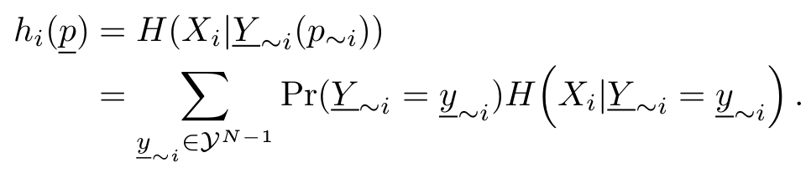
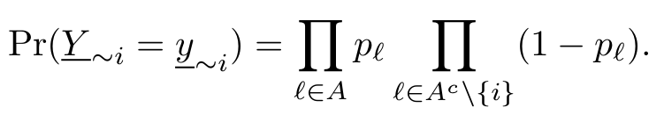

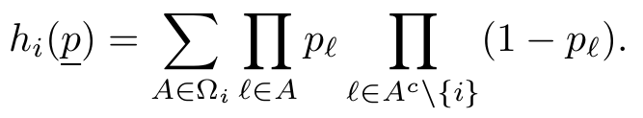
MAP EXIT function ...as a measure of a set
Proof:
by definition of conditional entropy,
WOLOG assume all 0's were sent.due to error pattern A , few bits got erased.
thus,
Now , if A ∈ Ω_{i} , then decoding fails hence , ,else 0.
thus,
the result follows on considering, p_{l}=p.

Slide 11
MAP EXIT function ...Influences of Ω_{i}
flip j
The measure of this set is the j-th influence of Ω_{i}
Ω_{i}
flip j

Slide 12
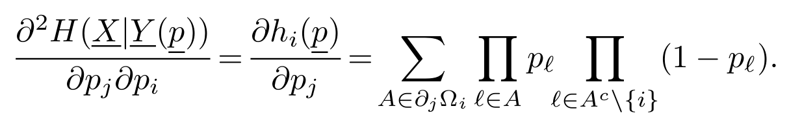
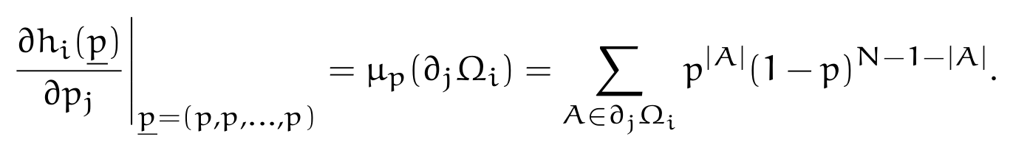
MAP EXIT function ...Influences of Ω_{i}
Proposition 3(b),4(b), jth partial derivative of h_{i}(p) is jth influence of Ω_{i} :
Proof: similar to proposition 3(a),4(a)
We need to show next :
all influences are equal, hence the set is symmetric ...
all hi(p) are equal , hence area theorem can be applied...
these will stem from the assumption that the code is 2-transitive

Slide 13

Permutation group...briefing
Symmetric group S_{N} of [N]:
Is the set of all permutations of N possible.
[N=3] , SN={{1,2,3},{1,3,2},{2,1,3}...}
Permutation group is a subset of symmetric group.
C
π
Considering [N] denotes the set of indices of a code a permutation operation(π) is a rearrangement of the bits of a code.
A Permutation automorphic group P_{Aut}(C) of a code is the permutation group , suchthat under π ∈ P_{Aut}(C) the membership of the code is preserved, we denote P_{Aut}(C), as

Slide 14






Permutation group...transitivity
code with bit 'b' at index i
if for any , there exists,
, such that
then is transitive.
C
π
code with bit 'b' at index j
code with bit 'b' at index i, bit 'c' at index j.
if for any , there exists,
, such that,
then is doubly-transitive.
C
π
code with bit 'b' at index i, bit 'c' at index k.

Slide 15
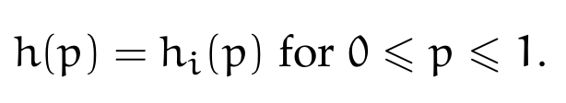
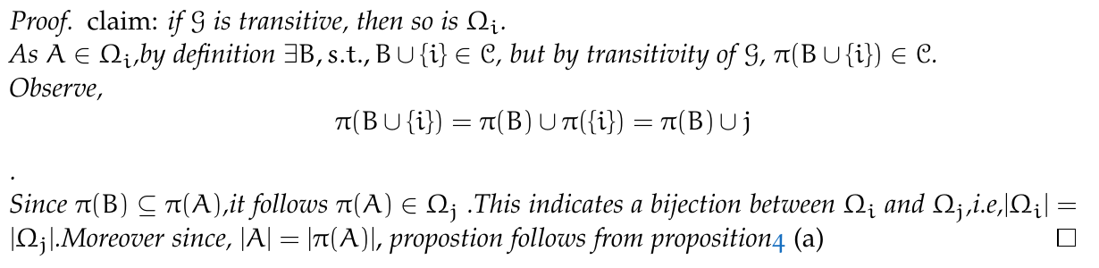
MAP EXIT function ...for doubly transitive code
Proposition 7, All EXIT functions are equal , for a transitive code:
i.e,using,

Slide 16
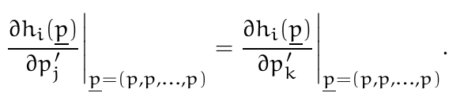

MAP EXIT function ...symmetry
Proposition 8, All Influences are equal , for a transitive code:
for distinct,
Proof:
Similar to Proposition 7.Intuitively we expect that once we permute the
locations , the bits which were pivotal must continue to remain so.Otherwise we could
have decoded the concerned bit using simple permutations.

Slide 17

Outline...
Probability of bit error
EXIT function
partial derivatives
Area theorem,connection to rate
Measure of a monotone* set
Influences of the set
Applicability of Area theorem
2-Transitivity of code
Symmetry
Equivalence of Capacity to threshold phenomenon of EXIT function
Russo's lemma and Threshold phenomenon
2-transitive codes are Capacity achieving
Reed Muller/polar codes are capacity achieving

Slide 18

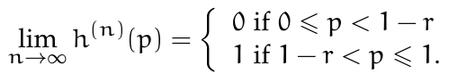

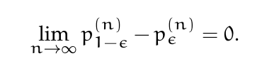

Capacity achieving codes...equivalence
Suppose {C_{n}} is a sequence of codes with rates {r_{n}} where r_{n} → r for
r ∈ (0, 1). a) {Cn} is said to be capacity achieving on the BEC under bit-MAP decoding, if for any p ∈ [0, 1 − r), the average bit-erasure probabilities satisfy,
The following are equivalent,
S1: {Cn } is capacity achieving on the BEC under bit-MAP decoding.
S2: The sequence of average EXIT functions satisfies
S3: For any,
note,
While S1 S2 , follows from relationship between h_{i}(p) and probability of bit error ,the rest follow from area theorem

Slide 19
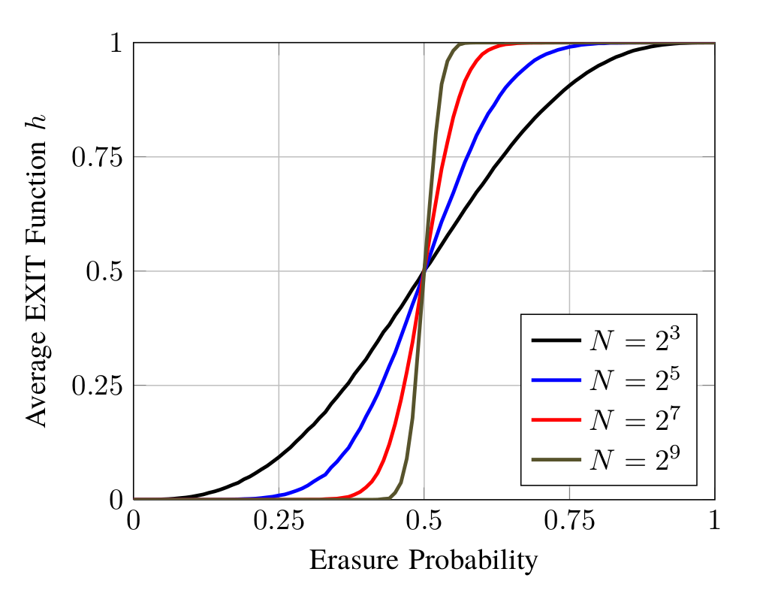
Capacity achieving codes...
The average EXIT function of Rate-1/2 RM-code with,Block length N.
Shows threshold phenomenon.

Slide 20

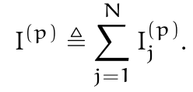



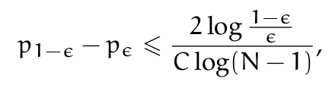
Main result...threshold phenomenon
Influence:
for a Monotone set Ω, the j-th influence is defined as.
the total, Influence is defined as,
Theorem 19:Let Ω be a monotone set and suppose that, for all the influences of all bits are equal ,i.e,
Then, for any
where p_{t} = inf{p ∈ [0, 1] : μp(Ω) > t} is well defined because μp(Ω) is strictly increasing in p with μ₀(Ω) = 0 and μ₁(Ω) = 1.
Proof: follows from Russo's lemma

Slide 21
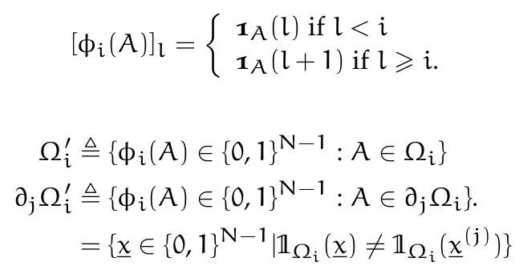
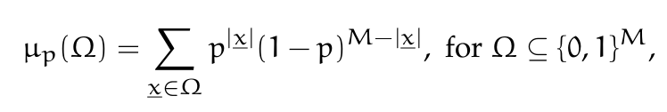
Main result...notations
Redefinitions
We can redefine Ω_{i} as a set of indicator vectors of A.
Accordingly ,we can refine the definition of the measure...

Slide 22

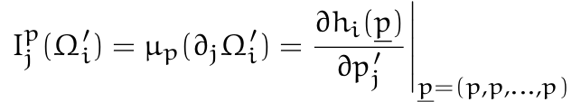


Main result...
Let {C_{n}} be a sequence of codes where the blocklengths satisfy N_{n} → ∞, the rates satisfy r_{n} → r, and the permutation group G_{(n)}(of C_{n}) is doubly transitive for each n. If r ∈ (0, 1), then {C_{n} } is capacity achieving on the BEC under bit-MAP decoding.
Proof:
Note, , , where h^{(n)}(p) is the EXIT function of C_{n.}
Properties of Ω_{i}'
Ω_{i}' is the set of error patterns that prevent the detection of Xi.
Consider A ∈ Ω_{i}' , any B > A will surely cause error.Hence B ∈ Ω_{i}' and thus,
Ω_{i}' is monotone.
Recall,
hence, thus Ω_{i}' is symmetric.
This implies,
Hence , and C_{n} achieves Capacity.

Slide 23
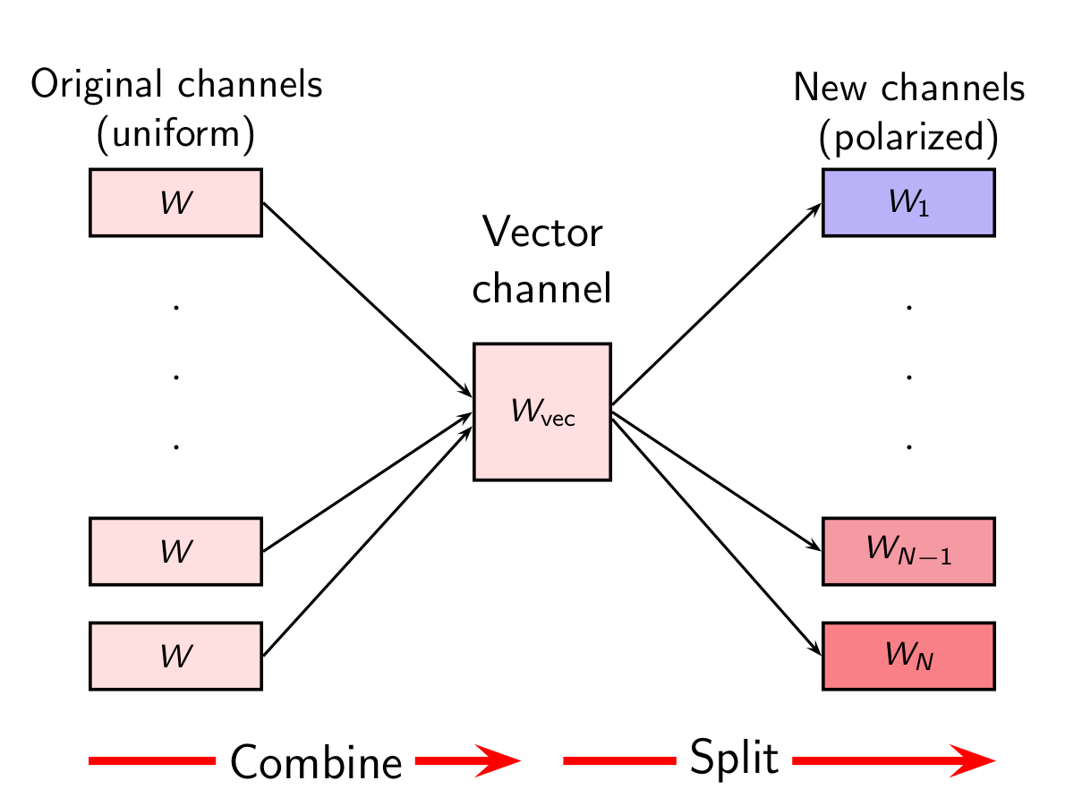
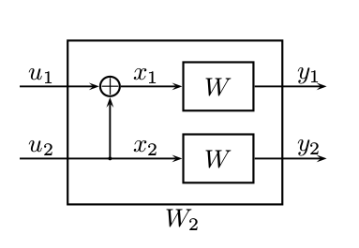

Polar codes are Capacity achieving... Introduction to polar codes
Channel polarization is an operation by which one manufactures out of N independent copies of a given B-DMC W,a second set of N channels {W^{(i)}_{N} : 1 ≤ i ≤ N } that show a polarization effect in the sense that, as N becomes large,the symmetric capacity terms {I(W^{(i)}_{N} )} tend towards 0 or 1,for all but a vanishing fraction of indices i. This operation consists of a channel combining and a channel splitting phase.

Slide 24
Polar codes are Capacity achieving... polar codes are doubly - transitive ,hence achieve capacity
Proof:
Assume we are given four distinct locations in the code a,b,c and d ∈ [N] ,we need to give a permutation π : [N] → [N] such that,
π(a) = c and π(b) = d , and it is automorphic.
Consider any permutation which satisfies the above constraint,proving it is automorphic suffices.
Note , π_{N×N} ∗ [u₁ ...u_{n} ] = [u _{π(1)} ...u _{π(n)} ]
and, π_{N×N} ∗ [x₁ ...x_{n} ] = [x_{π(1)} ...x_{π(n)} ]
Hence,upon premultiplying the encoding equation with π ,we get
π ∗ [x₁ ...x_{n} ] = π ∗ [u₁ ...u_{n} ] ∗ Gn
⇒ [x_{π(1)} ...x_{π(n)} ]=[u _{π(1)} ...u _{π(n)} ] ∗ Gn
As polar codes are linear , and [u _{π(1)} ...u _{π(n)} ] is a valid message, so [x_{π(1)} ...x_{π(n)} ] is a
valid codeword too.hence proved

Slide 25
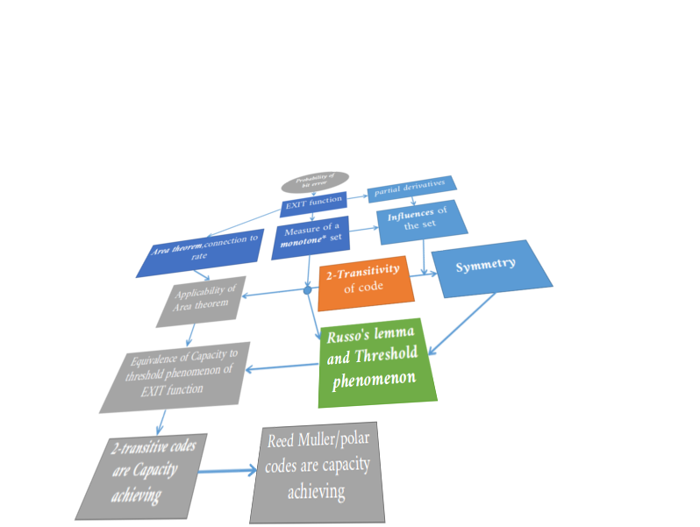
Thanks...

